Slide 1


INDIAN INSTITUTE OF SCIENCE EDUCATION AND RESEARCH, BHOPAL
Department Of Electrical Engineering and Computer Sciene
Signals and Systems- MODULE 1
Prepared By-
Amay Singh , Piyush Rai , Disha Mahato , Srasti Bijwani

Slide 2
MODULE 1 : SIGNAL AND SYSTEM
CONTENT
  INTRODUCTION
  CONTINOUS TIME AND DISCRETE TIME SIGNALS
  SIGNAL ENERGY AND POWER
  TRANSFORMATION OF INDEPENDENT VARIABLE
  PERIODIC SIGNALS
  EVEN AND ODD SIGNALS
  EXPONENTIAL AND SINUSOIDAL SIGNALS
  UNIT IMPULSE AND UNIT STEP FUCTIONS
  CONTINUOUS AND DISCRETE TIME SYSTEMS
  INTERCONNECTION OF SYSTEMS
  BASIC SYSTEM PROPERTIES

Slide 3
INTRODUCTION
  The concepts of signals and systems arise in a wide variety of fields, and the ideas and techniques associated with these concepts play an important role in such diverse areas of science and technology as communications, aeronautics and astronautics, circuit design, acoustics, seismology, biomedical engineering, energy generation and distribution systems, chemical process control, and speech processing.
  Signals are represented mathematically as functions of one or more independent variables. For example, a speech signal can be represented mathematically by acoustic pressure as a function of time, and a picture can be represented by brightness as a function of two spatial variables.

Slide 4
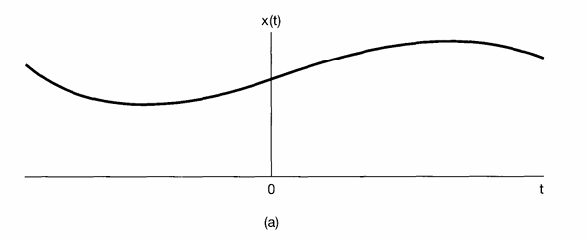
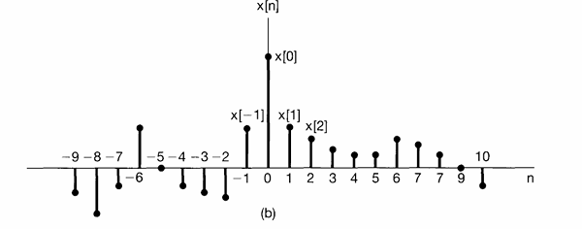
TYPES OF SIGNALS
TWO BASIC TYPES
Continuous Time Signal:
It is a signal in which independent variable is continuous. We will use the symbol t to denote the continuous-time independent variable. For continuous-time signals we will enclose the independent variable in parentheses (·)
Discrete Time Signal:
For these signals, the independent variable takes on only a discrete set of values. We will use n to denote the discrete time independent variable. For discrete-time signals we will use brackets [ · ] to enclose the independent variable.
Fig. Graphical representations of (a) continuous-time and (b) discrete time signals.

Slide 5
SIGNAL ENERGY AND POWER
The total energy over the time interval t1 ≤ t ≤ t2 in a continuous-time signal x(t) is defined as
∫t1t2|x(t)|² dt
Similarly, the total energy in a discrete-time signal x[n] over the time interval n1 ≤ n ≤ n2 is defined as
∑ₙ₌ₙ₁ⁿ² |x[n]|²
In many systems we will be interested in examining power and energy in signals over an infinite time interval, i.e., for -∞ < t < +∞ or for -∞ < n < +∞. In these cases, we define the total energy, in continuous time,
E∞ ≜ lim₍T→∞₎ ∫₋Tᵀ |x(t)|² dt = ∫₋∞∞ |x(t)|² dt
and in discrete time,
E∞ ≜ lim₍N→∞₎ ∑ₙ₌₋ᴺᴺ |x[n]|² = ∑ₙ₌₋∞∞ |x[n]|²
We can define the time-averaged power over an infinite interval as for continuous time signal,
P∞ ≜ lim(T→∞) 1/(2T) ∫₋Tᵀ |x(t)|² dt
and for discrete time signal,
P∞ ≜ lim(N→∞) 1/(2N+1) ∑ₙ₌₋ᴺᴺ |x[n]|²

Slide 6
SIGNAL ENERGY AND POWER
With these definitions, we can identify three important classes of signals :
  The first of these is the class of signals with finite total energy, i.e., those signals for which E∞ < ∞ . Such signals must have zero average power.
  A second class of signals are those with finite average power P∞ .
  There are signals for which neither P∞ nor E∞ are finite.

Slide 7
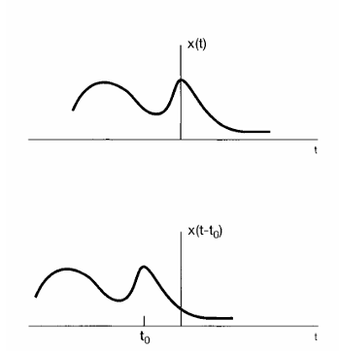
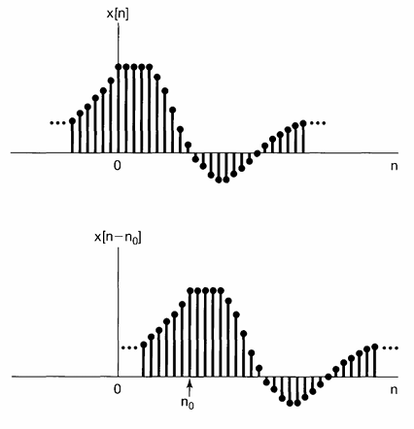
TRANSFORMATION OF INDEPENDENT VARIABLE
1.Time Shift :
Fig. Continuous-time signals related by a time shift. In this figure t0 < 0, so that x(t - to) is an advanced version of x(t) (i.e., each point in x(t) occurs at an earlier time in x(t - to)).
Fig. Discrete-time signals related by a time shift. In this figure n0 > 0, so that x[n- n0] is a delayed version of x[n] (i.e., each point in x[n] occurs later in x[n- n0]).

Slide 8
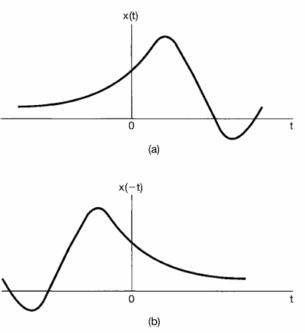
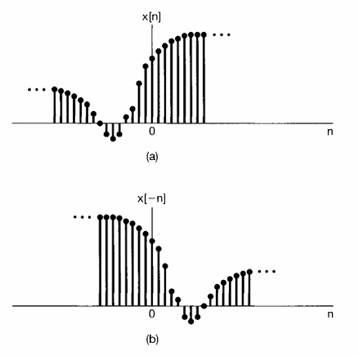
2.Time Reversval :
Fig. (a) A continuous-time signal x(t); (b) its reflection x( - t) about t = 0.
Fig. (a) A discrete-time signal x[n]; (b) its reflection x[-n] about n = 0.

Slide 9
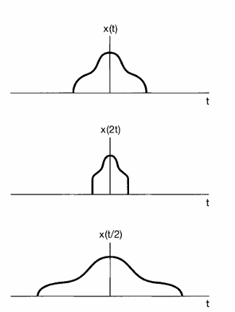
TRANSFORMATION OF INDEPENDENT VARIABLE
3.Time Scaling:
Fig. Continuous-time signals related by time scaling.

Slide 10
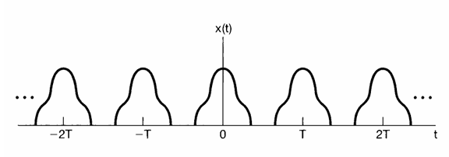
PERIODIC SIGNALS
Continuous Periodic Signal :
  A periodic continuous-time signal x(t) has the property that there is a positive value of T for which x(t) = x(t + T) for all values oft. In other words, a periodic signal has the property that it is unchanged by a time shift of T.
  The fundamental period To of x(t) is the smallest positive value of T.
  If x(t) is a constant. In this case the fundamental period is undefined, since x(t) is periodic for any choice of T (so there is no smallest positive value).
  A signal x(t) that is not periodic will be referred to as an aperiodic signal.
Fig. A continuous periodic signal

Slide 11
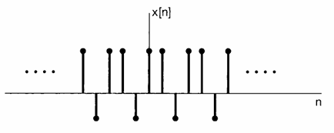
PERIODIC SIGNALS
Discrete Periodic Signal :
  A discrete time signal x[n] is periodic with period N, where N is a positive integer, if it is unchanged by a time shift of N, i.e., if x[n] = x[n + N] for all values of n.
  The fundamental period N0 is the smallest positive value of N.
Fig. A discrete-time periodic signal with fundamental period No= 3.

Slide 12
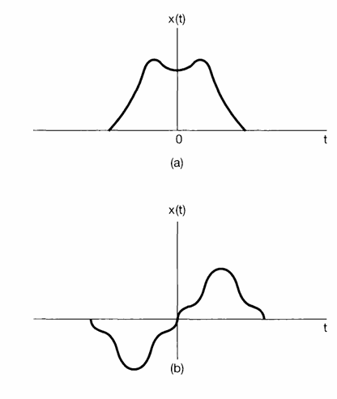
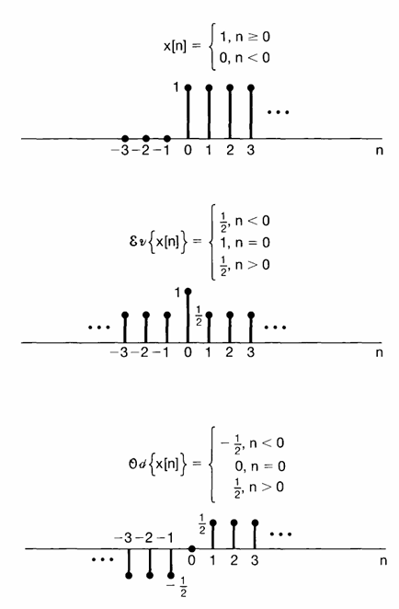
EVEN AND ODD SIGNALS
  A signal x(t) or x[n] is referred to as an even signal if it is identical to its time-reversed counterpart, i.e., with its reflection about the origin.
  In continuous time a signal is even if x(-t) = x(t), while a discrete-time signal is even if x[-n] = x[n].
  A signal is referred to as odd if x( -t) = - x(t), x[-n] = -x[n].
Fig. (a) An even continuous-time signal; (b) an odd continuous-time signal.
Fig. Example of the even odd decomposition of a discrete-time signal.

Slide 13
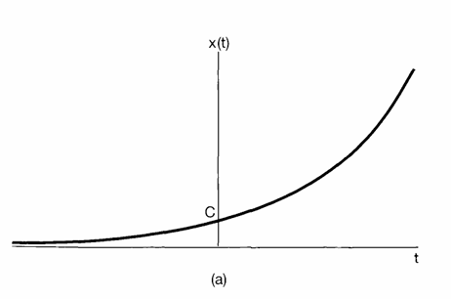
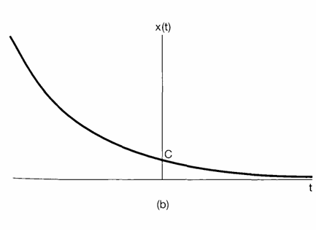
EXPONENTIAL AND SINUSOIDAL SIGNALS
Continuous-Time Complex Exponential and Sinusoidal Signals
The continuous-time complex exponential signal is of the form x (t) = Ceat where C and a are, in general, complex numbers. Depending upon the values of these parameters, the complex exponential can exhibit several different characteristics.
Real Exponential Signals :
if C and a are real [in which case x(t) is called a real exponential]
Fig. Continuous-time real exponential : (a) a > 0; (b) a< 0.

Slide 14
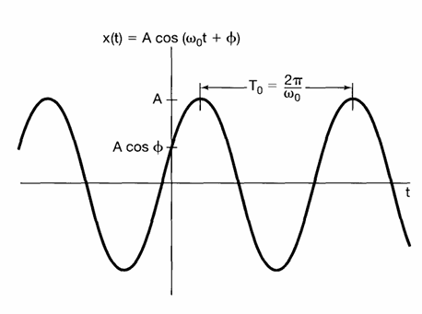
Periodic Complex Exponential and Sinusoidal Signals :
A second important class of complex exponentials is obtained by constraining a to be purely imaginary. Specifically, consider x(t) = ejw0t
An important property of this signal is that it is periodic.
A signal closely related to the periodic complex exponential is the sinusoidal signal x(t) =A cos (w0t +φ)
Fig. Continuous-time sinusoidal signal.

Slide 15
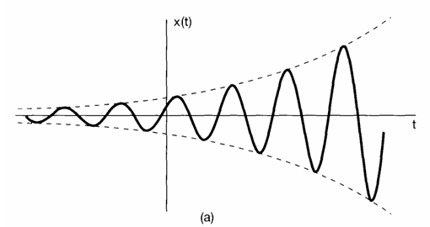
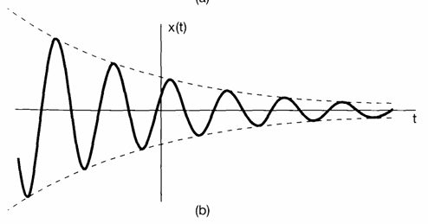
General Complex Exponential Signals :
A complex exponential C eat, where C is expressed in polar form and a in rectangular form. That is,
C eat = |C| ert cos (w0t+θ)+j|C|eRT sin(w0t+θ) .
For r = 0, the real and imaginary parts of a complex exponential are sinusoidal. For r > 0 they correspond to sinusoidal signals multiplied by a growing exponential, and for r < 0 they correspond to sinusoidal signals multiplied by a decaying exponential.
Fig. (a) Growing sinusoidal signal
Fig. (b) decaying sinusoid

Slide 16
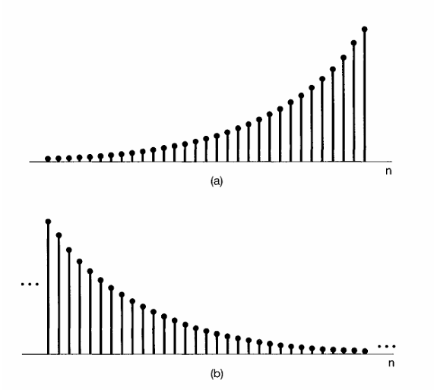
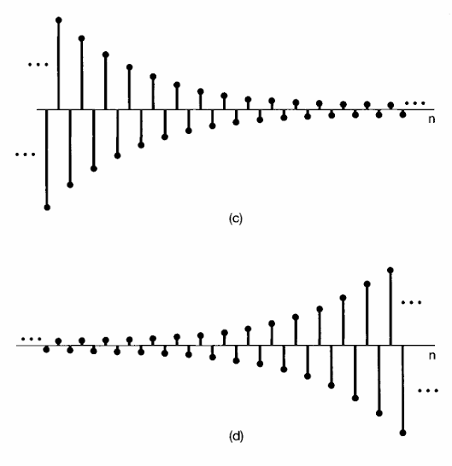
Discrete-Time Complex Exponential and Sinusoidal Signals
In discrete time , the complex exponential signal or sequence, is defined by x[n]=Can
where C and a are, in general, complex numbers.
Real Exponential Signals :
If C and a are real, we can have one of several types of behavior
Fig. The real exponential signal x[n] = Can: (a) a > 1; (b) 0 < a < 1; (c) -1 < a < 0; (d) a < -1

Slide 17
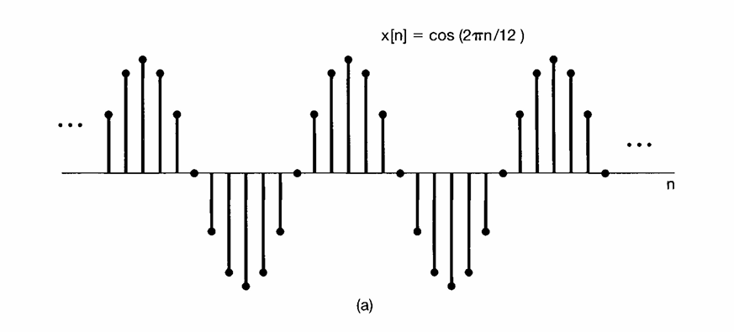
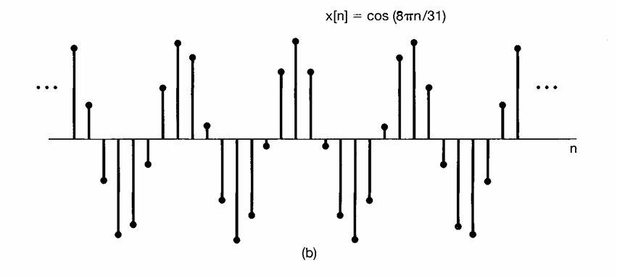
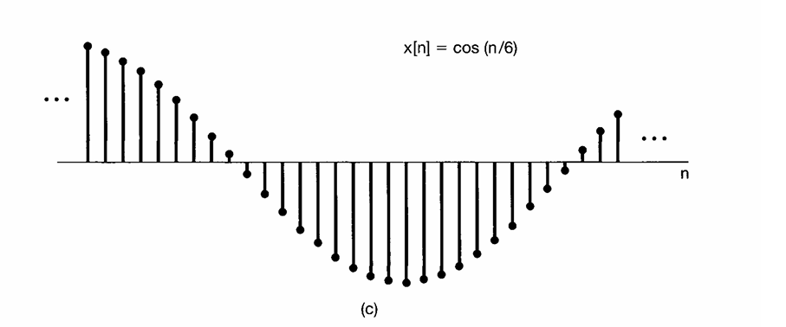
Sinusoidal Signal :
x[n] = Acos(w0n+φ)
Discrete-time sinusoidal signals.

Slide 18
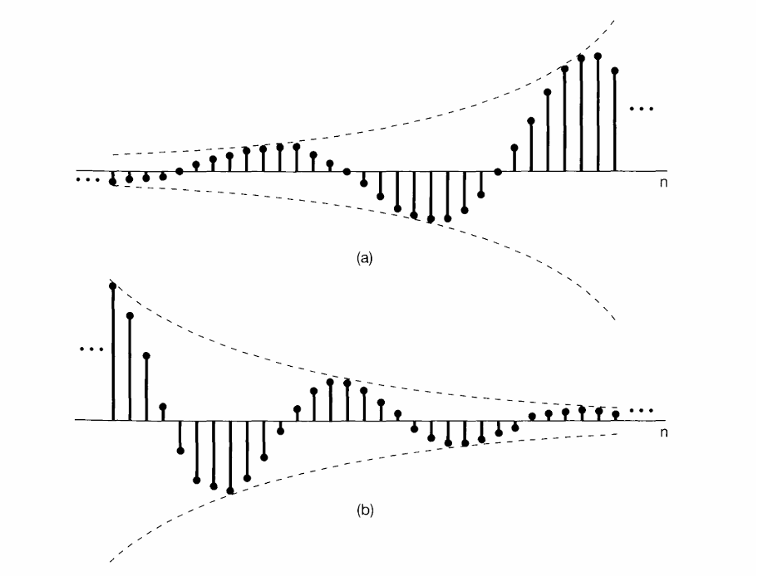
General Complex Exponential Signals :
C αn = |C||α|n cos (w0n+θ)+j|C||α|n sin(w0n+θ) .
(a) Growing discrete-time sinusoidal signals; (b) decaying discrete-time sinusoid.

Slide 19
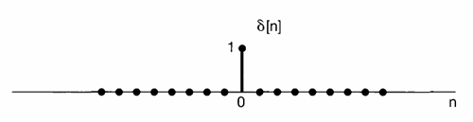


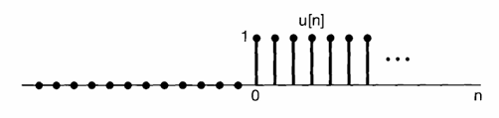
UNIT STEP AND UNIT IMPULSE FUNCTION
The Discrete-Time Unit Impulse and Unit Step Sequences
Discrete-time signals is the unit impulse (or unit sample), which is defined as
Discrete-time signal is the discrete-time unit step, denoted by u[n] and defined by

Slide 20
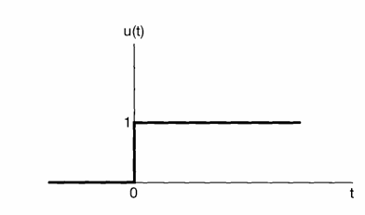

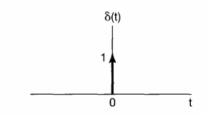

The Continuous-Time Unit Step and Unit Impulse Functions
The continuous-time unit step function u(t) is defined in a manner similar to its discrete time counterpart. Specifically,
The continuous-time unit step is the running integral of the unit impulse
Continuous time unit impulse.

Slide 21
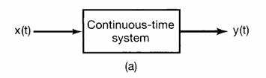
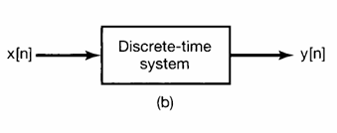
CONTINUOUS AND DISCRETE TIME SYSTEMS
Continuous Time System :
A continuous-time system is a system in which continuous-time input signals are applied and result in continuous-time output signals. We will often represent the input-output relation of a continuous-time system by the notation x(t) → y(t).
Discrete Time System :
A system that transforms discrete-time inputs into discrete-time output and will sometimes be represented symbolically as x[n] → y[n].

Slide 22
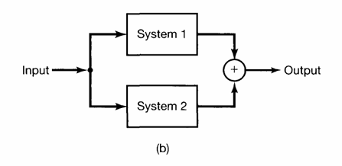
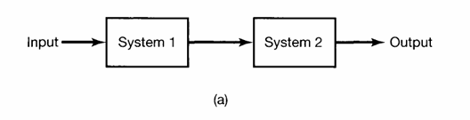
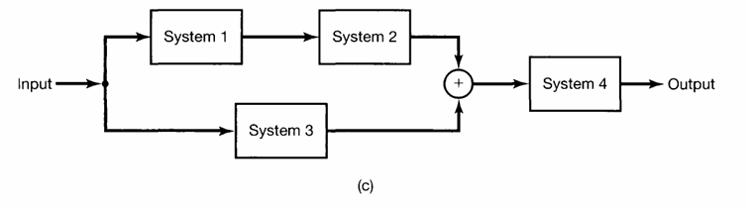
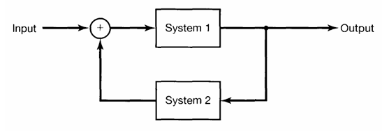
INTERCONNECTION OF SYSTEMS
(a) Series Interconnection
(b) Parallel Interconnection
( c ) Series-Parallel Interconnection
(d) Feedback interconnection

Slide 23
PROPERTIES OF SYSTEM
  Systems with and without Memory : A system is said to be memory less if its output for each value of the independent variable at a given time is dependent only on the input at that same time.
  lnvertibility and Inverse Systems : A system is said to be invertible if distinct inputs lead to distinct outputs.
  Causality : A system is causal if the output at any time depends only on values of the input at the present time and in the past. Such a system is often referred to as being nonanticipative, as the system output does not anticipate future values of the input.
  Stability : Stability is another important system property. Informally, a stable system is one in which small inputs lead to responses that do not diverge.
  Time lnvariance : Conceptually, a system is time invariant if the behavior and characteristics of the system are fixed over time.
  Linearity : A linear system, in continuous time or discrete time, is a system that possesses the impor tant property of superposition: If an input consists of the weighted sum of several signals, then the output is the superposition-that is, the weighted sum-of the responses of the system to each of those signals.

Slide 24
Module - 1
Completed

